Slide 1
Octane’22 Review Presentation
Project : Pad printing defect inspection system using Vision
Department : MTD R&A (Engineering)
Mentor : Pravin Marathe

Slide 2
Pad Printing
Pad printing is a printing process that can transfer a 2-D image onto a 3-D object.
Pad printing is used in automotive industry.
Indicator parts, Dashboard components, Wheels etc.

Slide 3
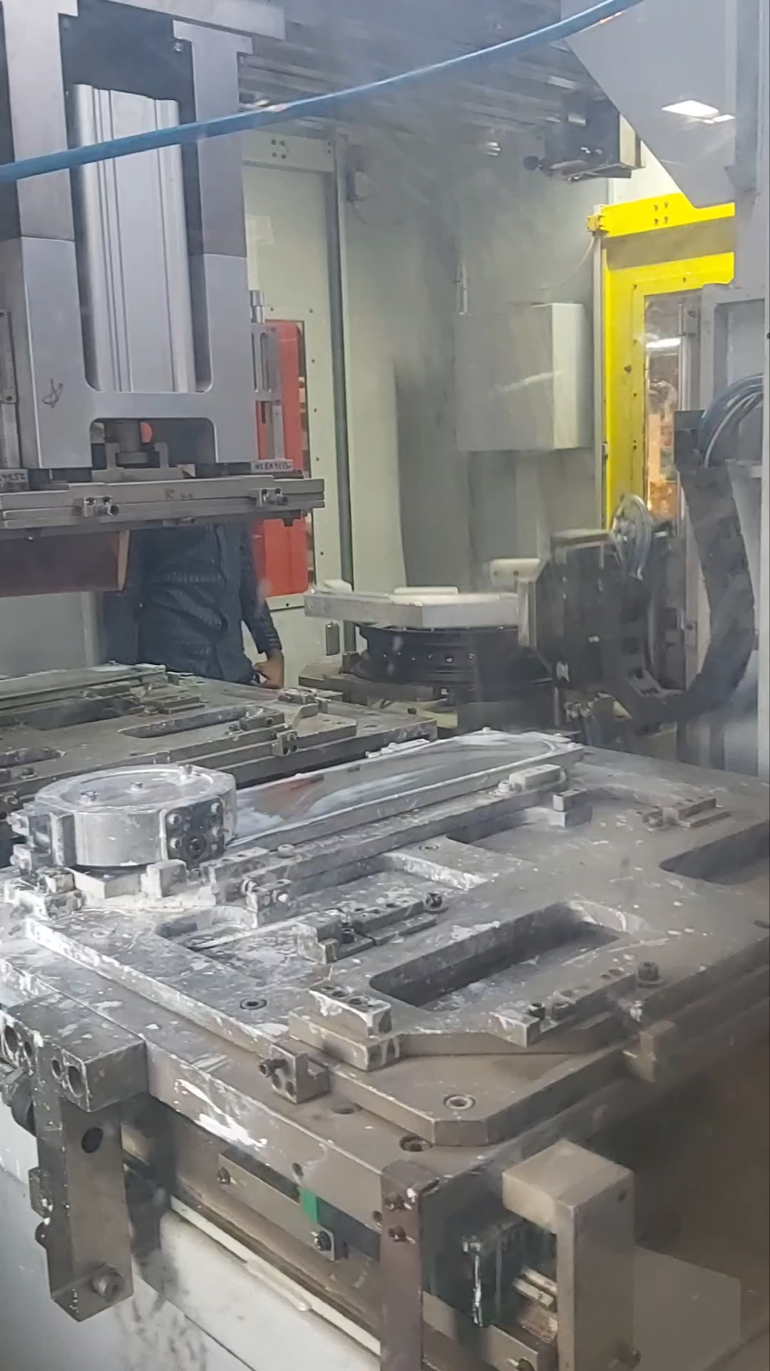
Pad Printing
Dataset collected from Vendor visit to BLG Logistics
Date: 13-06-2022

Slide 4
Possible defects
What are the possible defects in pad printing?
Print cut
Print shift
Partial print
Double print
Print edge burr
Print smudging

Slide 5
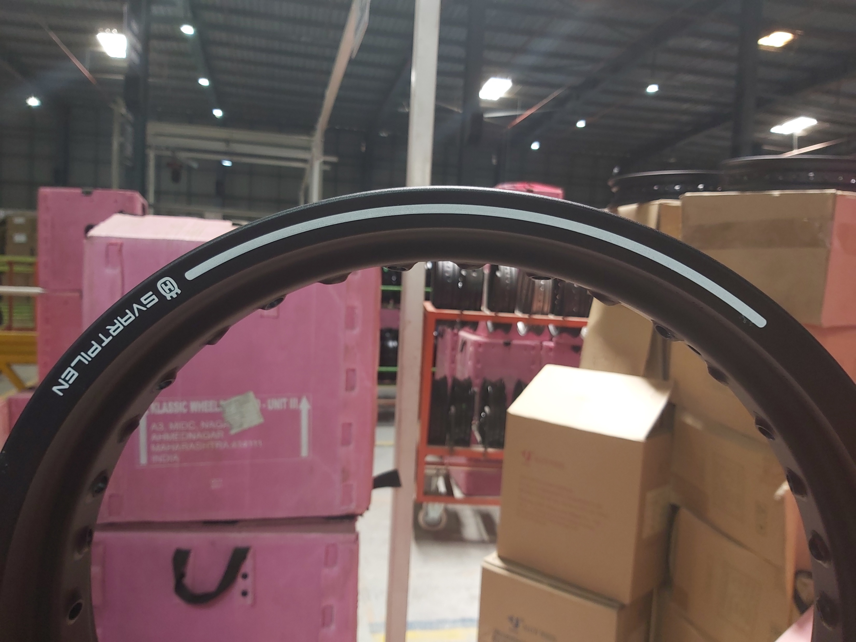
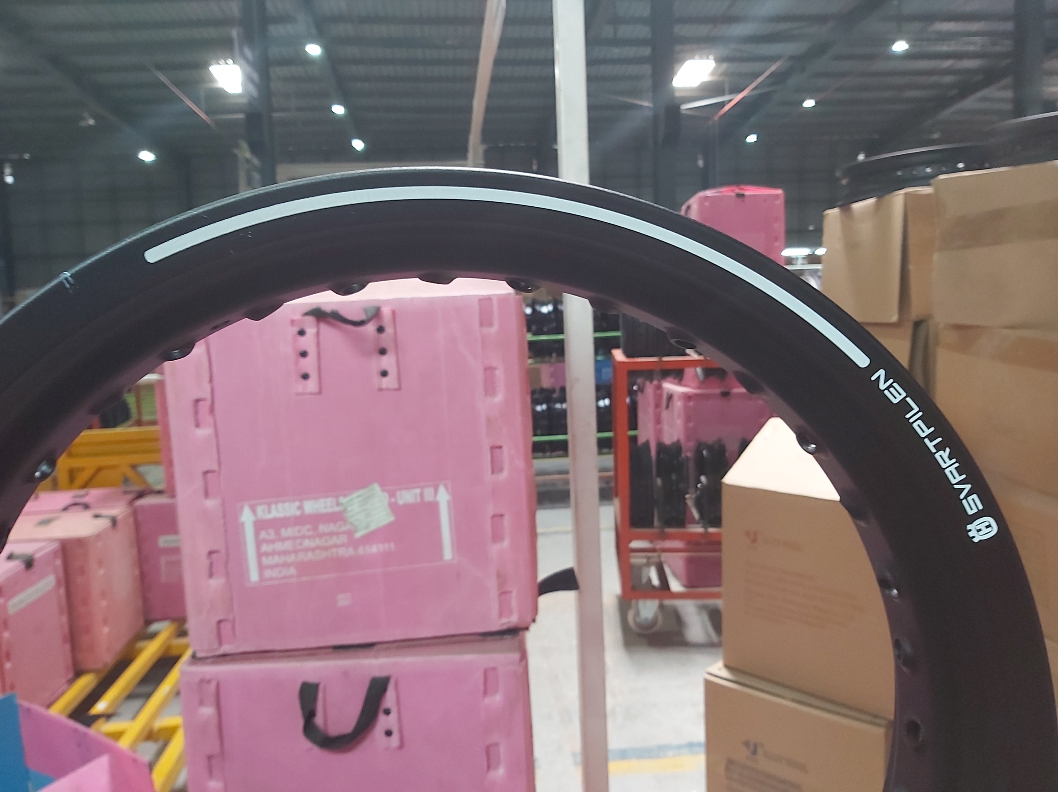
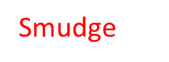
Possible defects
Print Smudge
Smudge

Slide 6
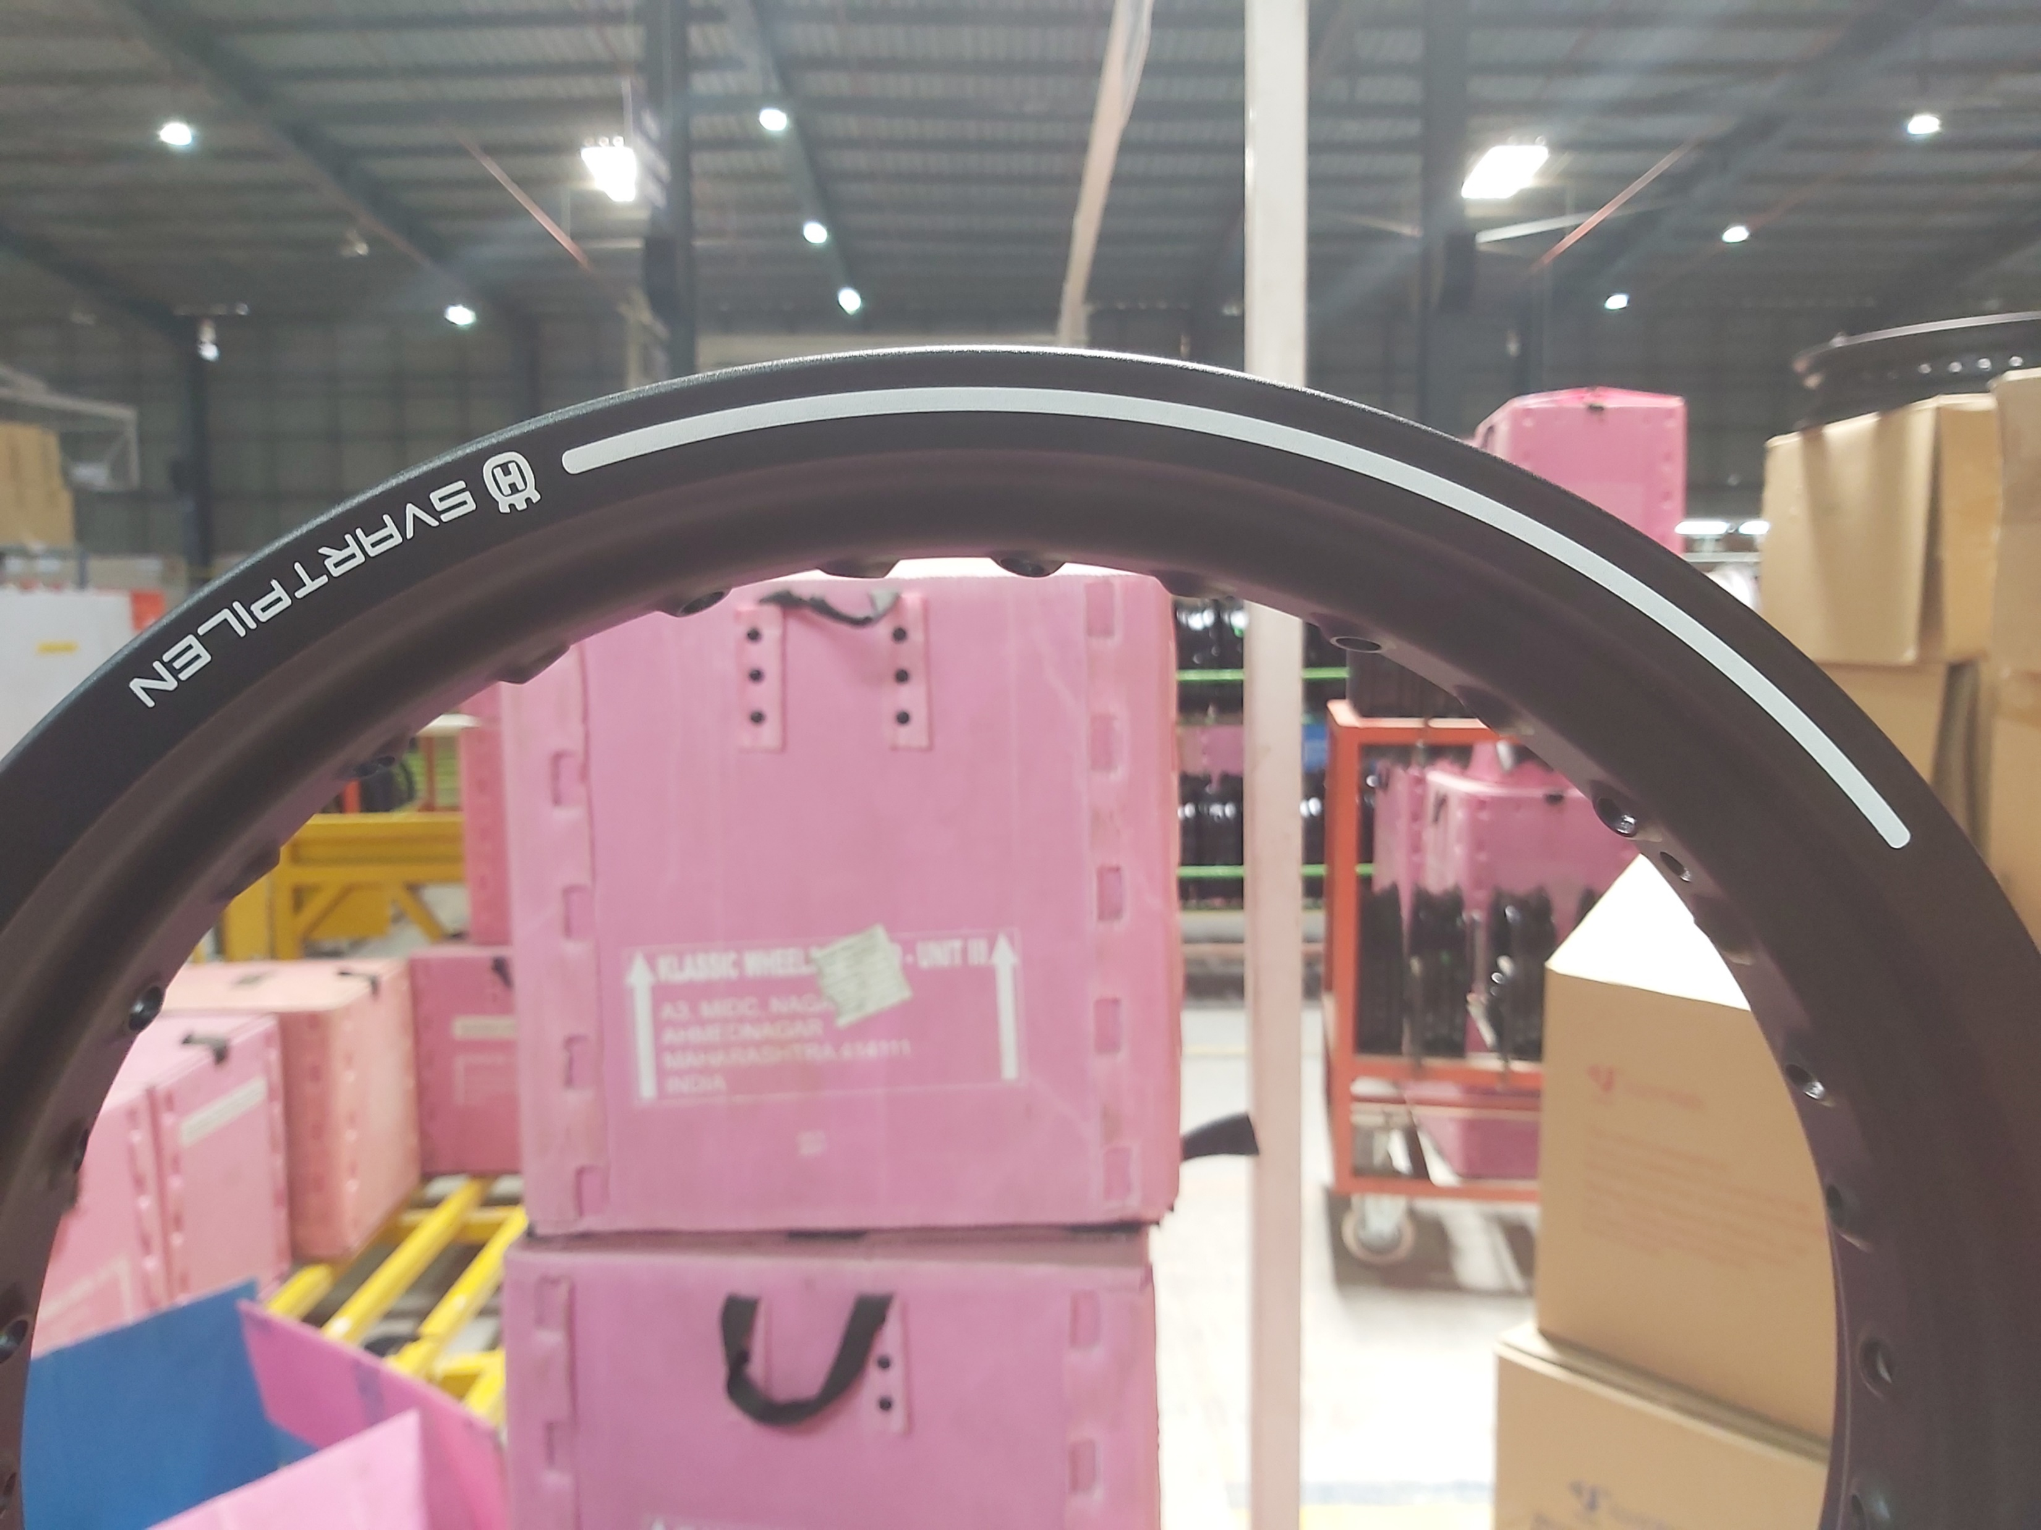
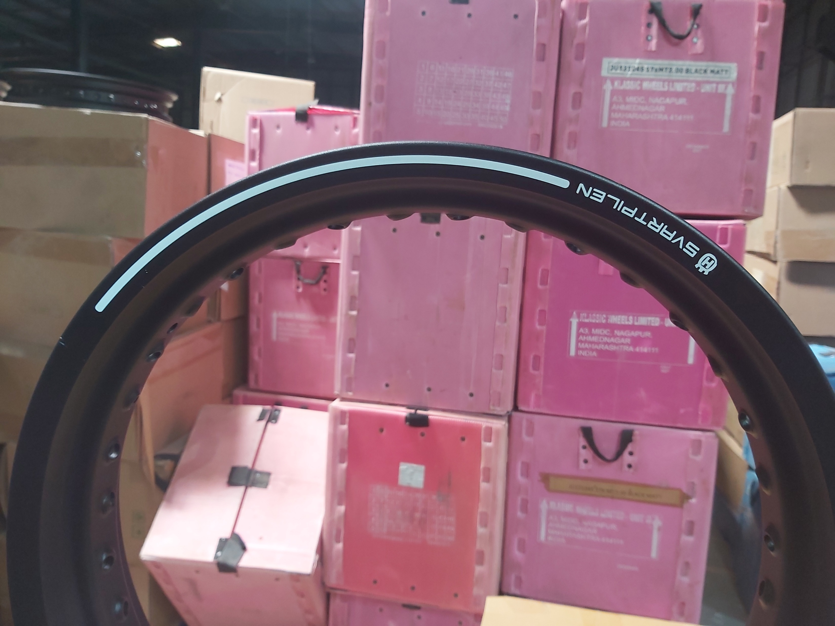
Possible defects
Print Cut
Cut at P
Cut at logo

Slide 7

Possible defects
Dust
Print Cut
Smudge

Slide 8
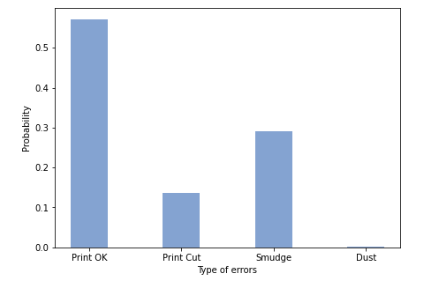
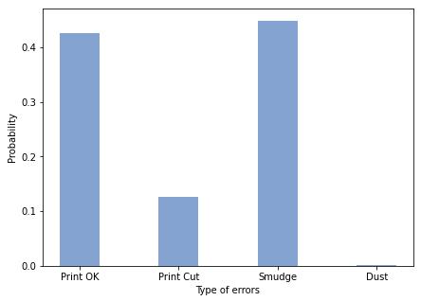
Probability of defects
(a) LH
(b)RH

Slide 9
Machine Vision Inspection System
Vision inspection systems provide image-based inspection automated for your convenience for a variety of industrial and manufacturing applications.
2D machine vision system is used.
Major components : Lighting, lens, image sensor.
Benefits:
Lowers Costs
Eliminates Human Error
Identifies Print Defects
Low inference time
Reliability
Simple Layout

Slide 10
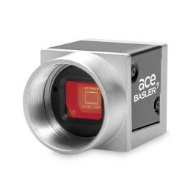
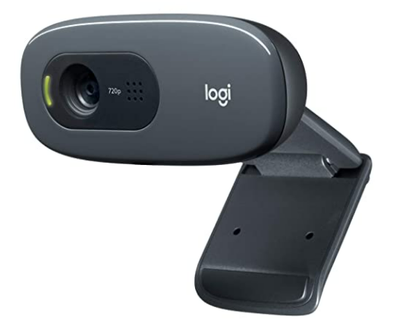
Vision system Camera
For identifying defects using OpenCV, camera used can be of low resolution
For identifying defects using deep learning, camera of high resolution should be used.
Bassler acA2500-14uc
Sensor : MT9P031
Shutter : Rolling Shutter
Sensor Type: CMOS
Sensor Size : 5.7 mm x 4.3 mm
Resolution : 5 MP
Frame Rate : 14 fps
Logitech C270
Sensor Type : CMOS
Resolution : 720p
Frame rate : 30 fps

Slide 11
Approach towards identifying defects
Print shift
Print Cut
Double print
Partial print
Print smudging
Print edge burr
Other defects like scratches, dust etc
OpenCV
Deep Learning

Slide 12
Image Pre-processing
Image
Thresholding
Edge detection
Masked image
Bitwise operation
Morphological Transformation
To improve the quality of the image so that we can analyze it in a better way.
Programming Language used: Python
Libraries used : OpenCV, NumPy, matplotlib

Slide 13
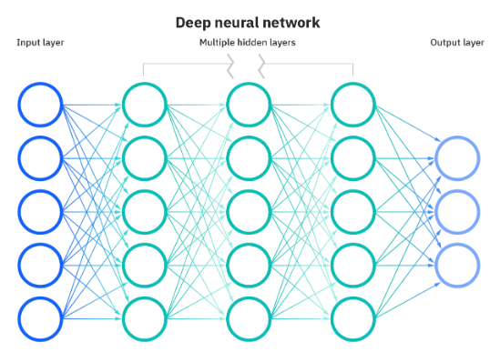
Deep Neural Networks
Why deep learning over machine learning?
Differ in how each algorithm learns and how much data each type of algorithm uses.
Deep learning automates much of the feature extraction piece of the process.
Neural Networks
If the output of any individual node
is above the specified threshold value,
that node is activated, sending data to
the next layer of the network.

Slide 14
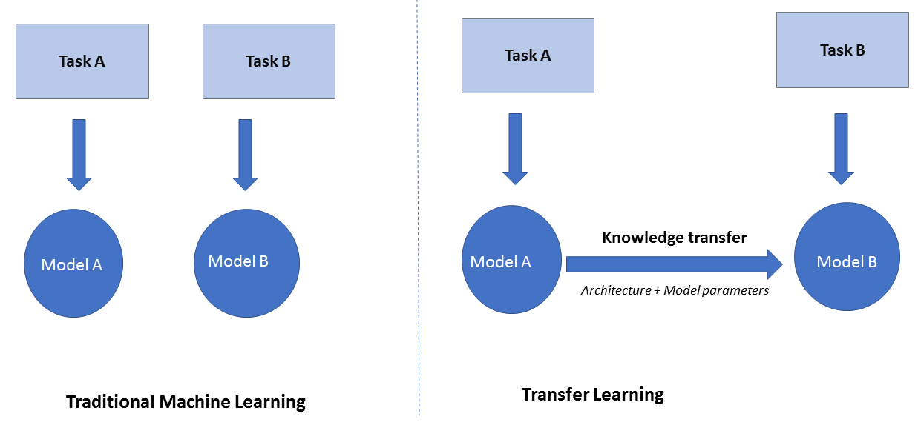
Transfer learning
Storing knowledge gained while solving one problem and applying it to a different but related problem.
Advantages:
Saves time and resources
Improves efficiency
Provides generalised way

Slide 15
GPU vs CPU
Pros
Cons
Requires less memory
Faster
Parallel instruction processing
High throughput
Weak cores
Less diverse
Serial instruction processing
Low latency
Google colab allows to connect to local runtime using Jupyter.
Deep Learning uses a lot of processing power.

Slide 16
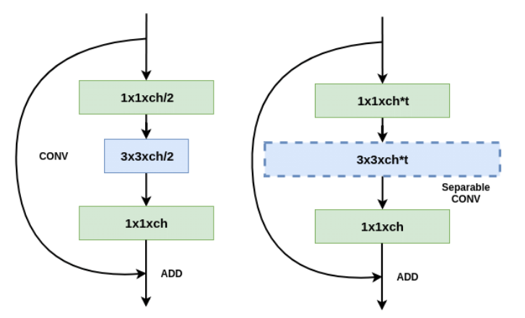
ResNet vs MobileNet-V2
Resnet
Identity shortcut connection
MobileNet-V2
Less no. of parameters
Resnet
Mobilenet V2

Slide 17
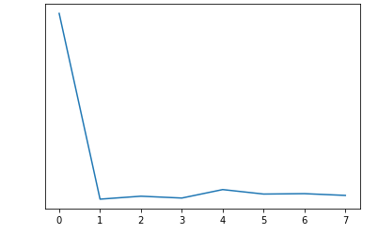
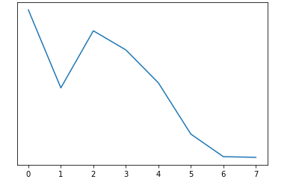
Loss function
Quantifies the difference between the expected outcome and the outcome produced by the model.
Backpropagation
Loss
Loss
Epochs
Epochs
ResNet
MobileNet-V2
Decreasing loss function as preferred.

Slide 18
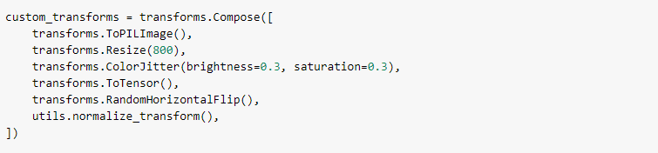
Data Augmentation
When there is limited data we increase our data set by performing some actions.
Flip
Rotation
Scale
Crop
Translation

Slide 19
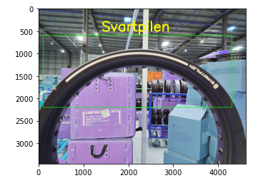
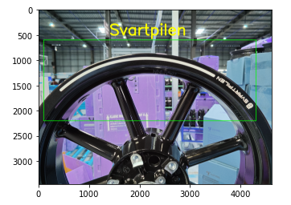
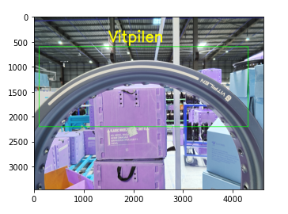
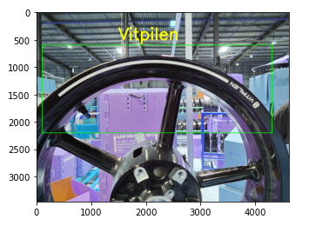
Model identification
Available models:
Svartpilen spoke black
Svartpilen alloy
Vitpilen spoke grey
Vitpilen alloy

Slide 20
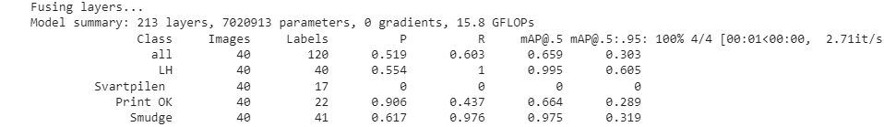
Output – Smudge defect

Slide 21
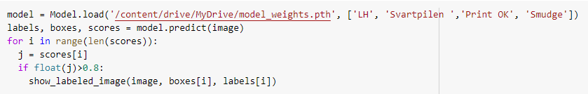
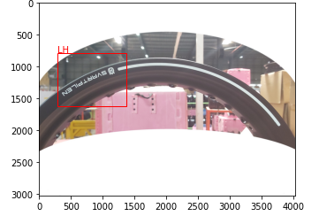
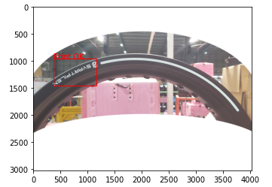
Output – Smudge defect

Slide 22
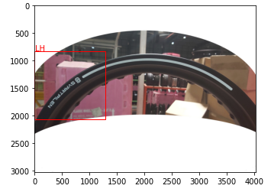
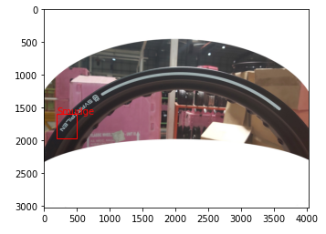
Output – Smudge defect

Slide 23
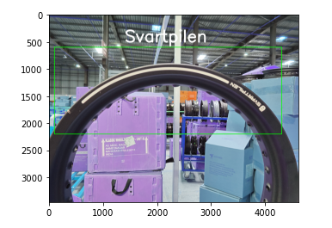

Key benefits
Wheel undergoes 3 stages of screening.
With this model, this will be reduced to one stage.
Algorithm-1
Model Identification
Algorithm-2
Identification of defects

Slide 24
Future work
Edge computing solutions
Jetson Nano
Eliminates trade off between speed, performance
Cost effective
Diversity among data
Optimization of parameters

Slide 25
References
Detecto documentation
Neural networks

Slide 26
Thank You!

